Slide 1
Course Topics
Data representations
Raw material for computations
Computer Architecture
Description of components and basic operations
Assembly Language
Programming view of the architecture of a particular computing system (low-level)
Discrete Math
Overview of math topics important to IT

Slide 2
View of Computer Systems
Programming Language
Application Programming Interface
Operating System
This course
Assembly Language
Computer Architecture
Digital Electronics

Slide 3
Why is this course important to an IT student?
Understand how hardware and software affect computing performance.
Understand the interface between the software and the hardware, and how does software instruct hardware to perform needed functions.
What math is foundational to becoming proficient in IT

Slide 4
What is Computer Architecture?
- The architecture of a computer is a logical description of its components and its basic operations.
- The view of a computer as presented to software designers

Slide 5
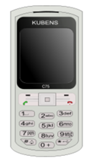
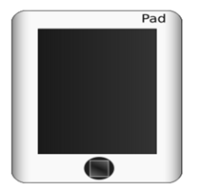
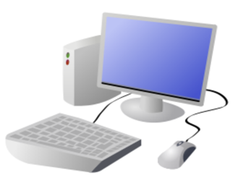
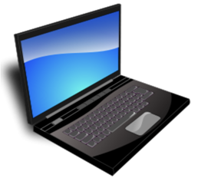
What is a Computer?
A computer is a general purpose device that can be programmed to process
information, and yield meaningful results.

Slide 6
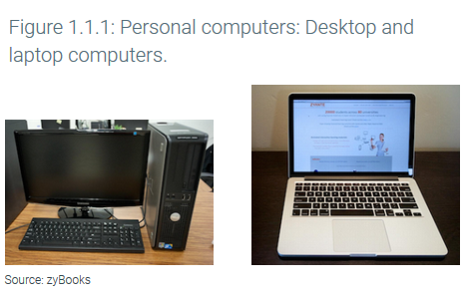
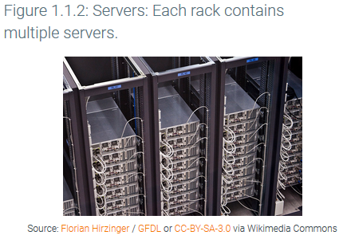
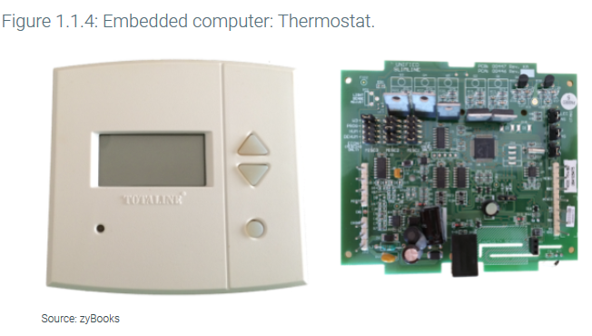
Classes of Computing
Personal Computer (PC) - computer designed for use by an individual, usually incorporating a graphics display, a keyboard, and a mouse
Embedded Computer - a computer inside another device used for running one predetermined application or collection of software. (Internet of Things or IOT)
Server - a computer used for running larger programs for multiple users, often simultaneously, and typically accessed only via a network.

Slide 7
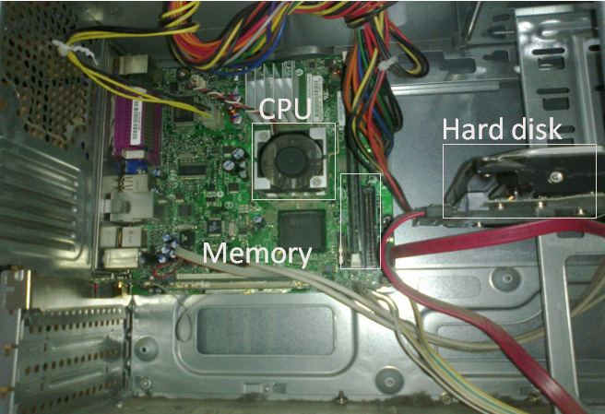
What does it look like inside a computer?

Slide 8
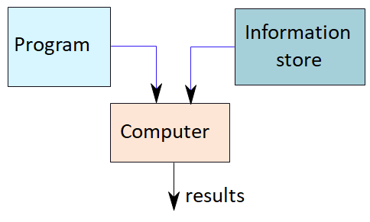
How does it work?
*Program – List of instructions given to the computer
*Information store – data, images, files, videos
*Computer – Process the information store according to the instructions in the program

Slide 9
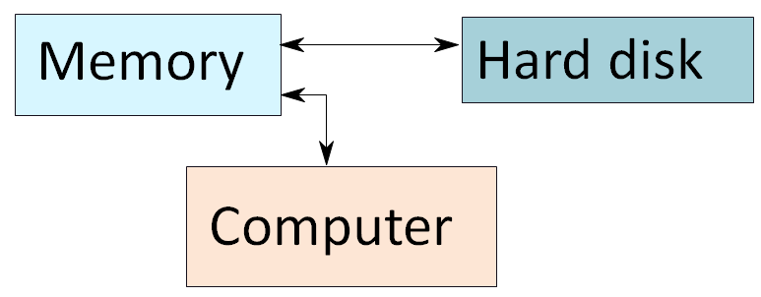
Simplified Computer Architecture
*Memory – Stores programs and data. Gets destroyed when the computer is powered off
*Hard disk – stores programs/data permanently

Slide 10
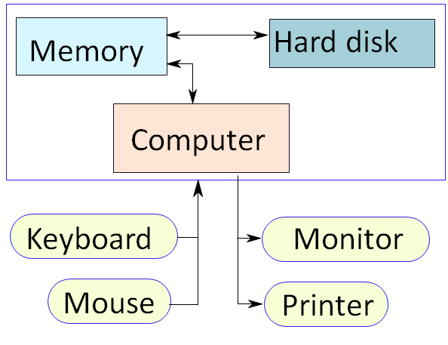
Additional details

Slide 11
Abstraction to simplify design
Both computer architects and programmers had to invent techniques to make themselves more productive
A major productivity technique for hardware and software is to use abstraction to represent the design at different levels of representation; lower-level details are hidden to offer a simpler model at higher levels.

Slide 12
Hardware
Physical components of a computing system
Input device: A mechanism through which the computer is fed information, such as a keyboard.
Output device: A mechanism that conveys the result of a computation to a user, such as a display, or to another computer.
Central processor unit (CPU): Also called processor. The active part of the computer, which contains the datapath and control and which adds numbers, tests numbers, signals I/O devices to activate, and so on.
Memory: The storage area in which programs are kept when they are running and that contains the data needed by the running programs.
Bus: Wires that connect the components

Slide 13
PostPC era concepts
Personal mobile devices (PMDs) small wireless devices to connect to the Internet; they rely on batteries for power, and software is installed by downloading apps. Conventional examples are smart phones and tablets.
Cloud computing large collections of servers that provide services over the Internet; some providers rent dynamically varying numbers of servers as a utility.
Software as a Service (SaaS) delivers software and data as a service over the Internet, usually via a thin program such as a browser that runs on local client devices

Slide 14
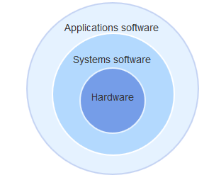
Hierarchy of Hardware and Software
Applications software: program designed for the end user.
Examples include such things as database programs, word processors, Web browsers and spreadsheets.
Systems software: Software that provides services that are commonly useful, including operating systems
Operating system: Supervising program that manages the resources of a computer for the benefit of the programs that run on that computer.
Examples of operating systems in use today are Linux, iOS, and Windows.

Slide 15
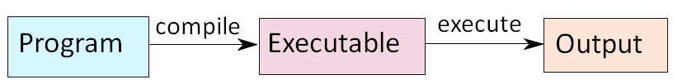
Instructions
A command that computer hardware interprets and executes
The CPU processes instructions
Programs are sequences of instructions

Slide 16
What can a Computer "understand"?
*Computer can clearly NOT understand instructions of the form
*Calculate the area of a circle
*Complete my online order
*Find the shortest path between Portsmouth, NH and NYC
*They understand :
*Add a + b to get c
*Move data from this spot in computer to that spot

Slide 17
The Language of Instructions
*Humans can understand
*Complicated sentences
*Computers can understand
*Very simple instructions
The semantics of all the instructions supported by a processor is known as its instruction set architecture (ISA).

